Slide 1
Online Safety:
Parent Session
October 2023

Slide 2
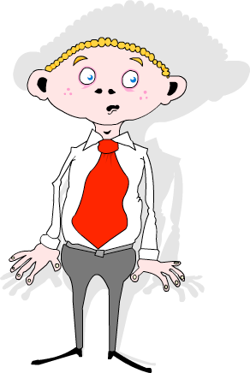
Introduction
Gary Melia
Schools IT Support Manager
0151 443 2155
gary.melia@knowsley.gov.uk
Notes:
My name is Gary Melia and I have the pleasure of managing the CLC team who have put this event on. As part of my role I have worked with schools on online safety for the past 15 years, its a passion of mine and I am excited by the day ahead we have planned for you.

Slide 3
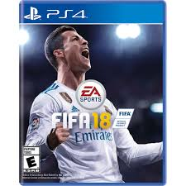
Children’s Digital Playground (6-12)
What are your children doing online?
Watch videos on YouTube or Tik Tok
Play a range of online games from Roblox and Fortnite to Toca Boca mobile games
Older children use apps such Instagram to share their stories online and live-stream
Some may also be using platforms like Twitch to watch others playing games.

Slide 4
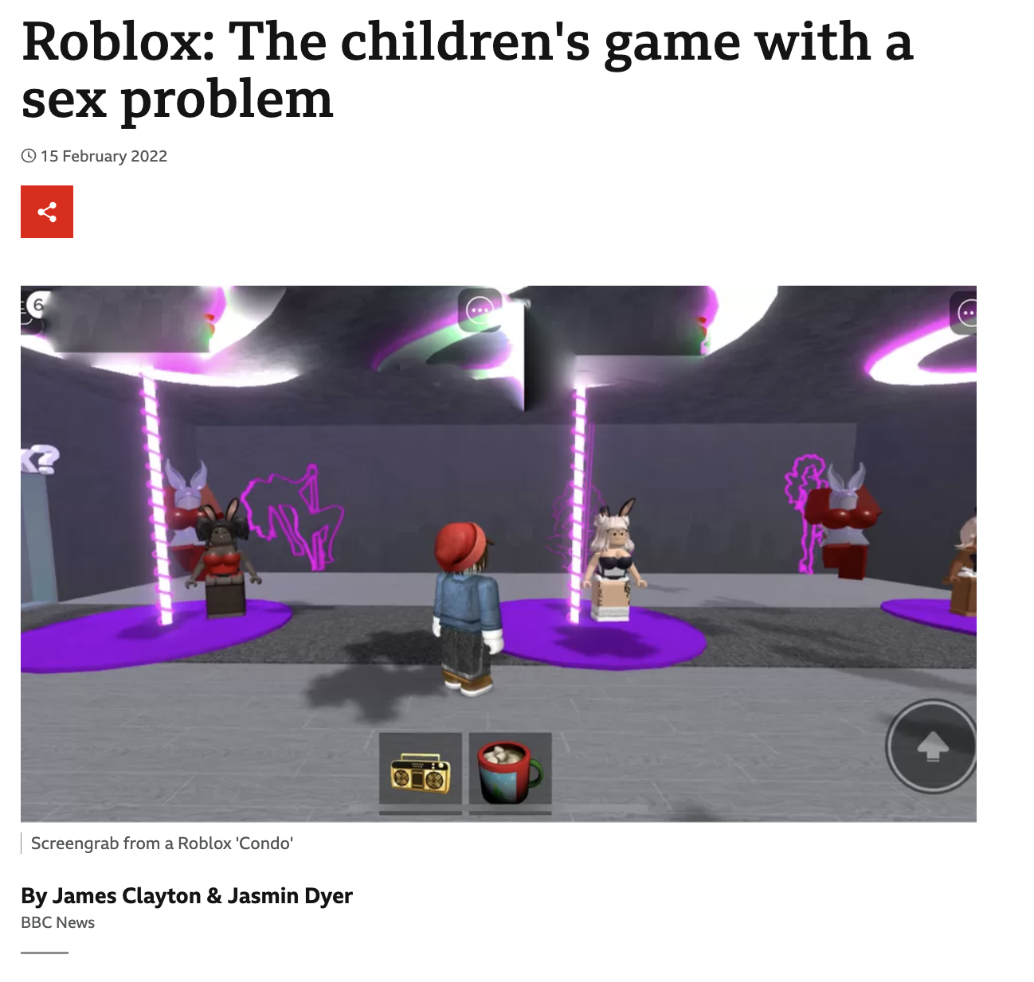
How well do you know Roblox?
Roblox PEGI Rating Now 13+
https://www.bbc.co.uk/news/technology-60314572

Slide 5
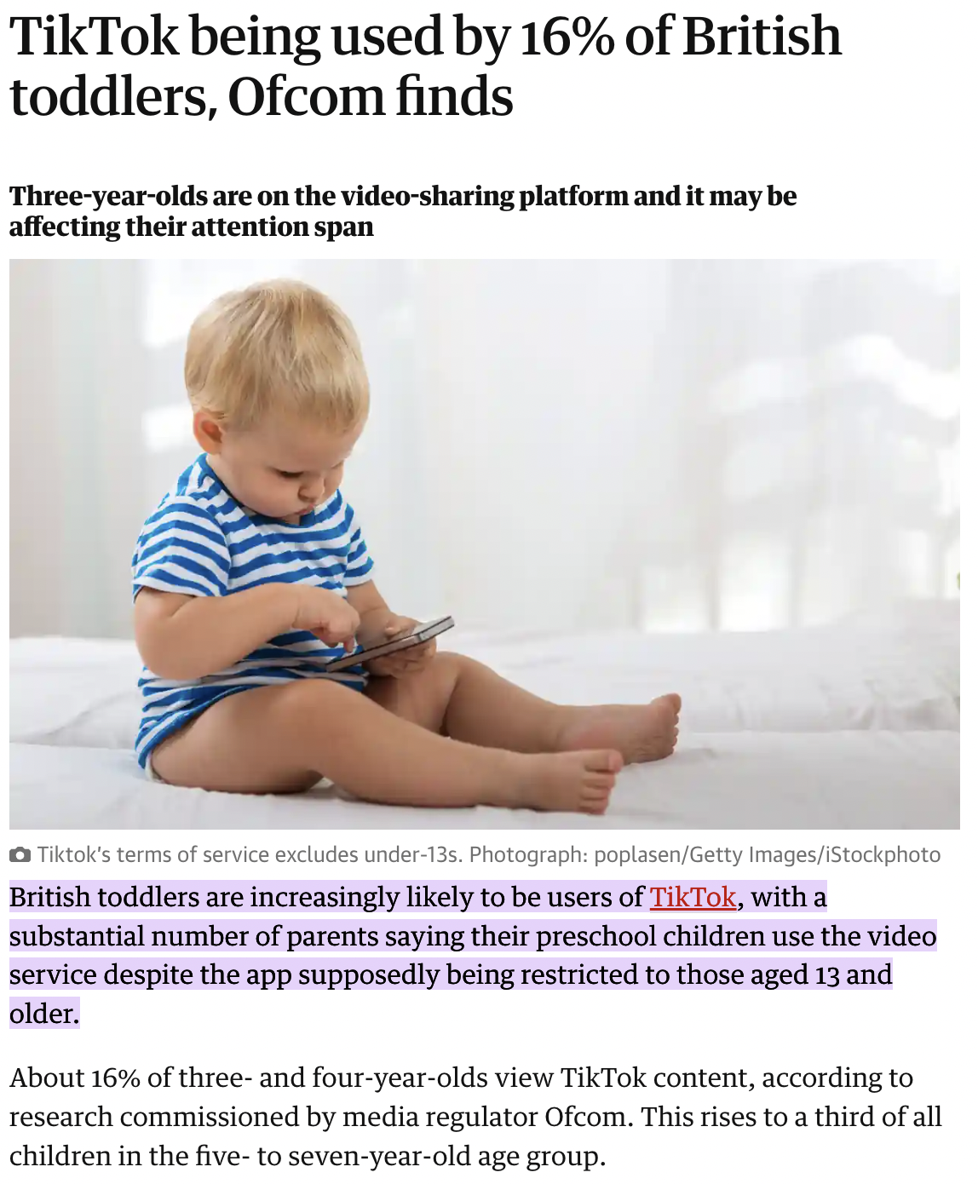
‘Tik Tots’
Table 1
23% of | 3+4 year olds
• 30% | of 5-7 year olds
• 63% | of 8-11 year olds
• 93% | of 12-15 year olds
• 97% | of 16+17 year olds

Slide 7
Platforms Flagged for
Severe Bullying
😢
The
Top 5
😢
👎🏻
Others to watch for:
Discord
Snapchat
Instagram
Kik
Tik Tok
Twitch
Hoop
Whatsapp

Slide 8
What can you do?
We don’t disclose because no one will help, and many will make it worse.

Slide 9
Do your children know what is expected of them online?

Slide 10
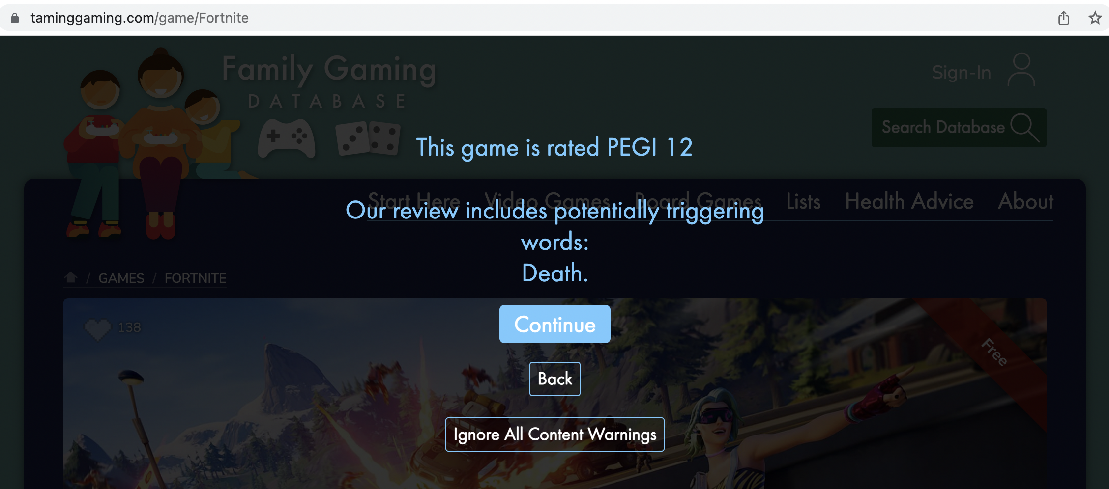
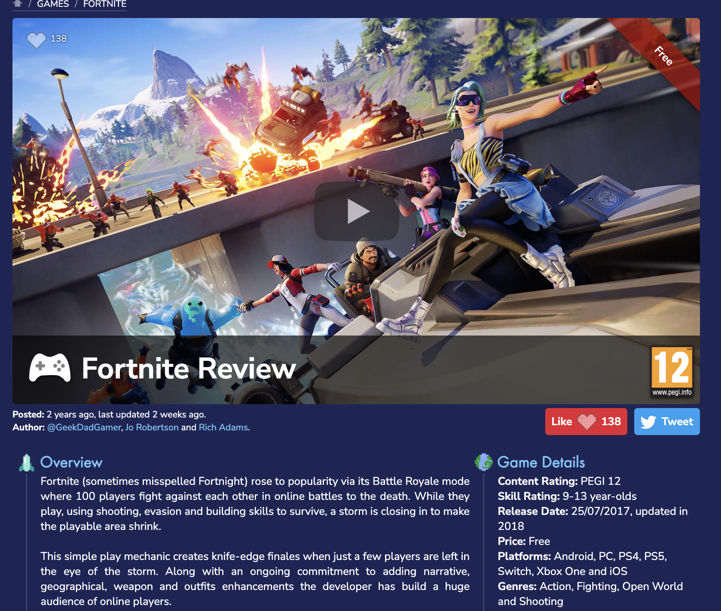
Taming Gaming

Slide 11
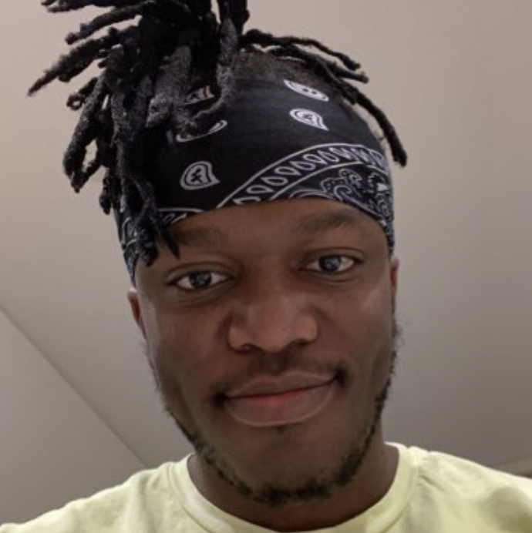
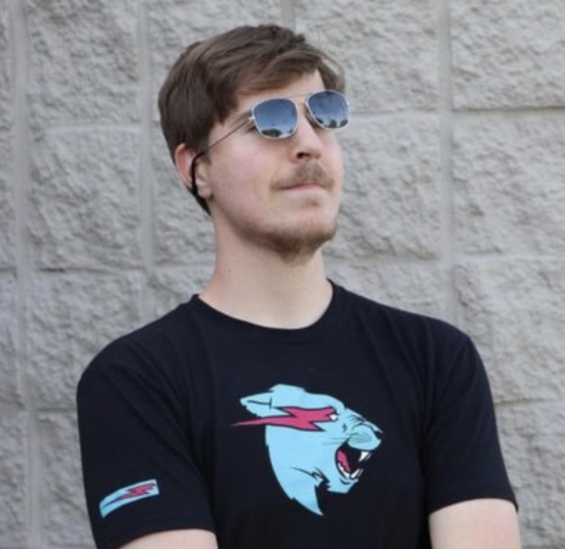
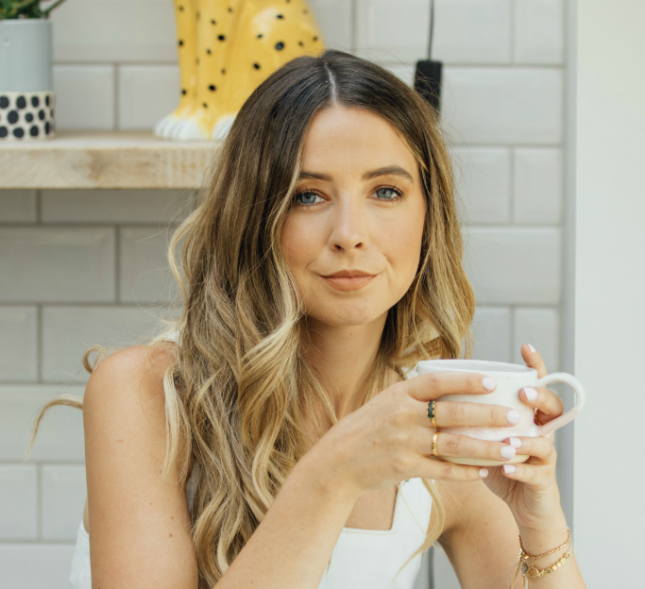
Do you know who your influencers?
What do you know about the influencers your children are interested in?

Slide 12
Do you know who your influencers?

Slide 13
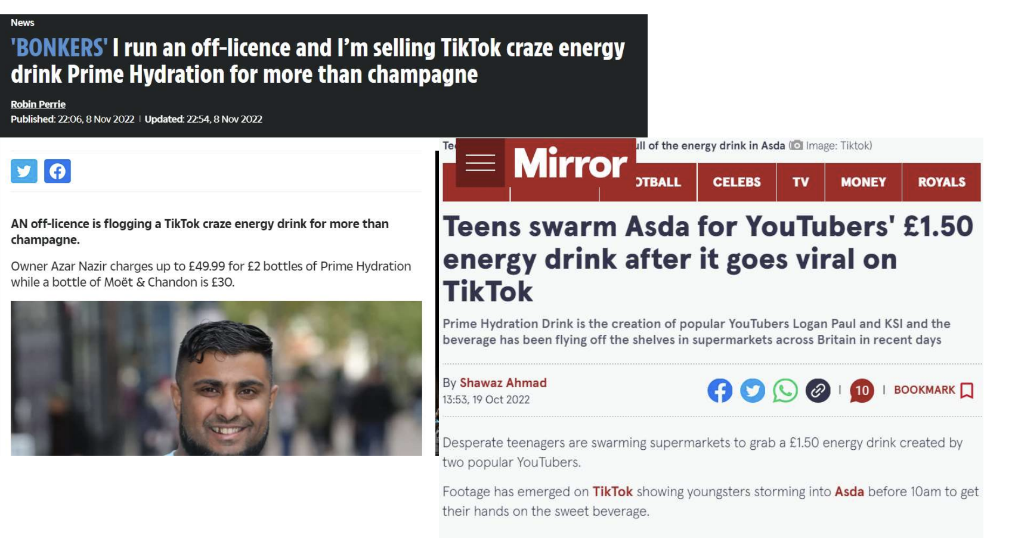
Do you know who your influencers?

Slide 14
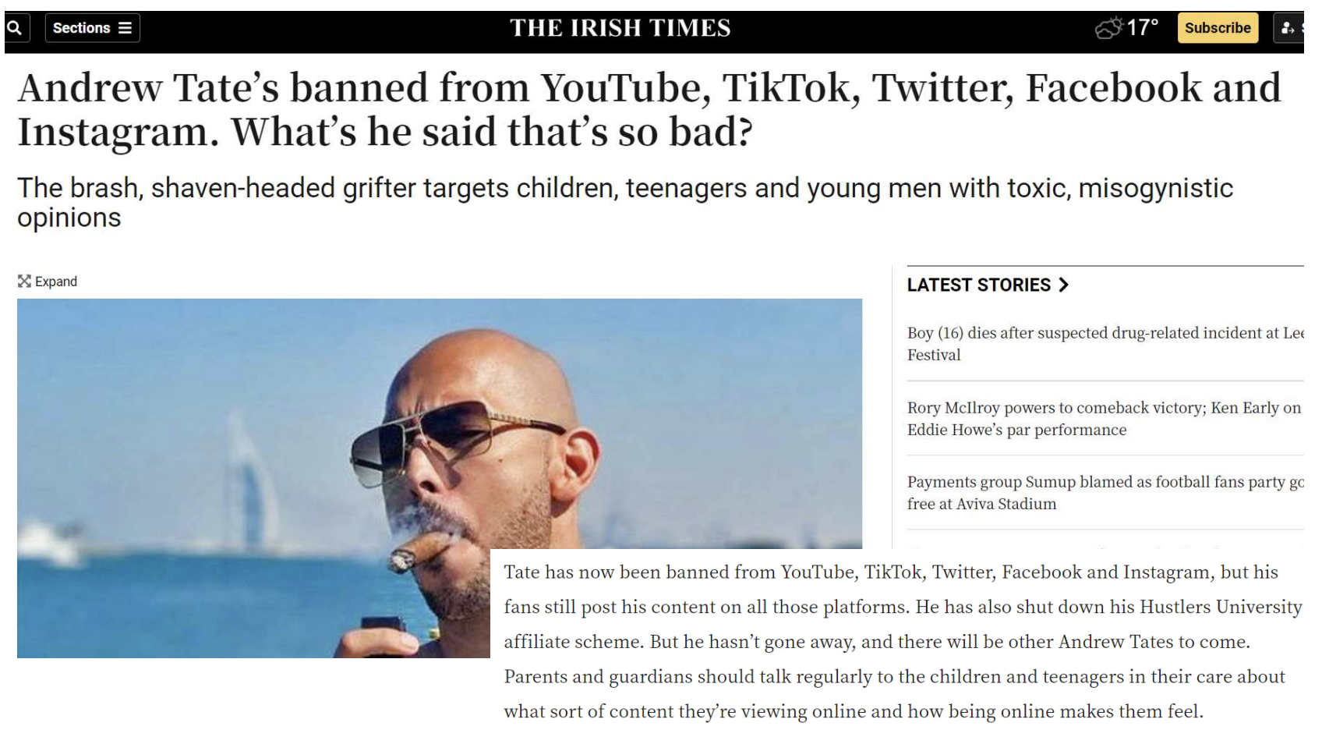
Do you know who your influencers?

Slide 15
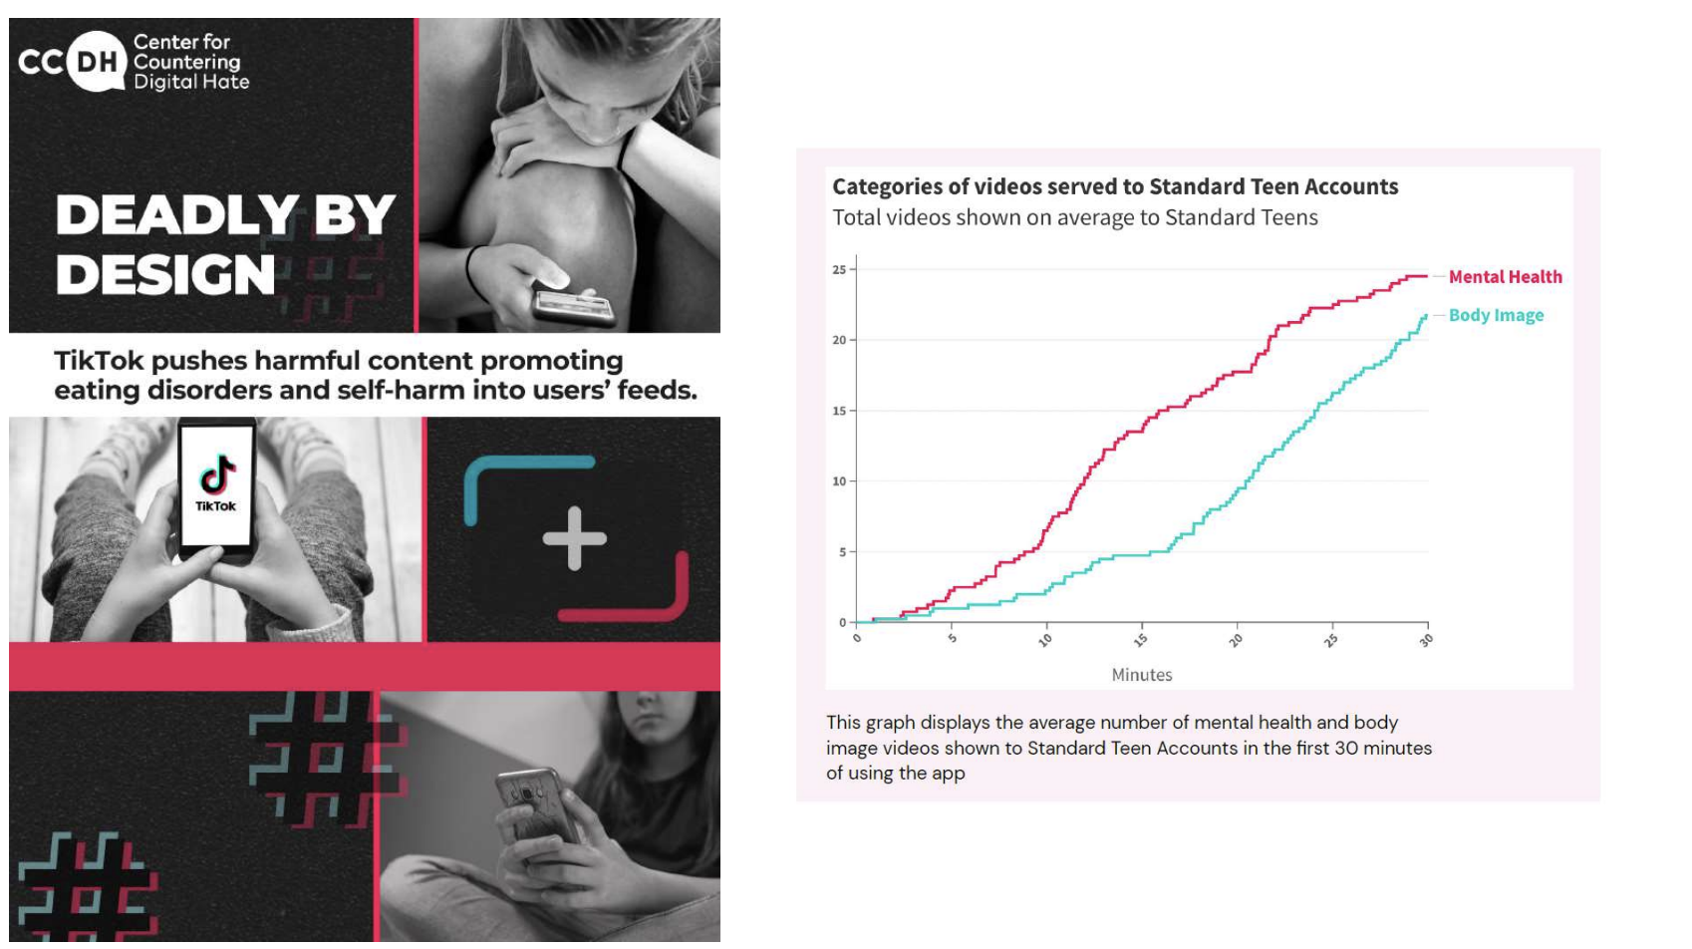

Slide 16
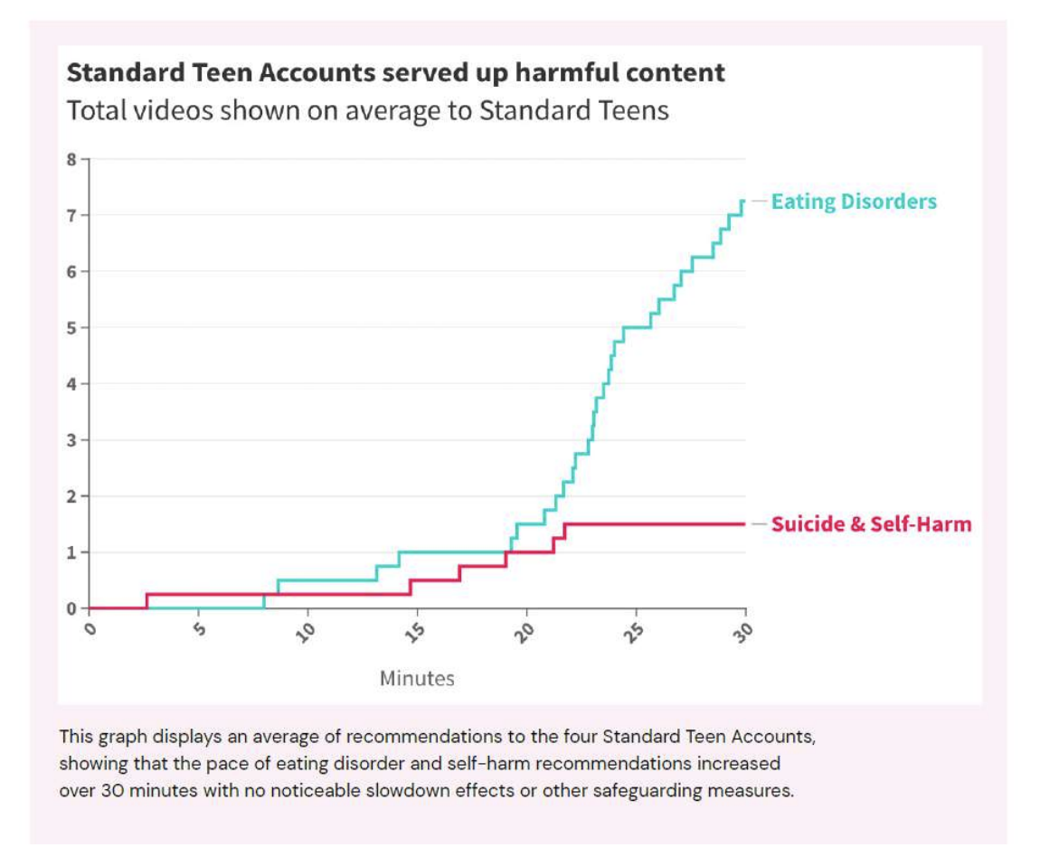

Slide 17
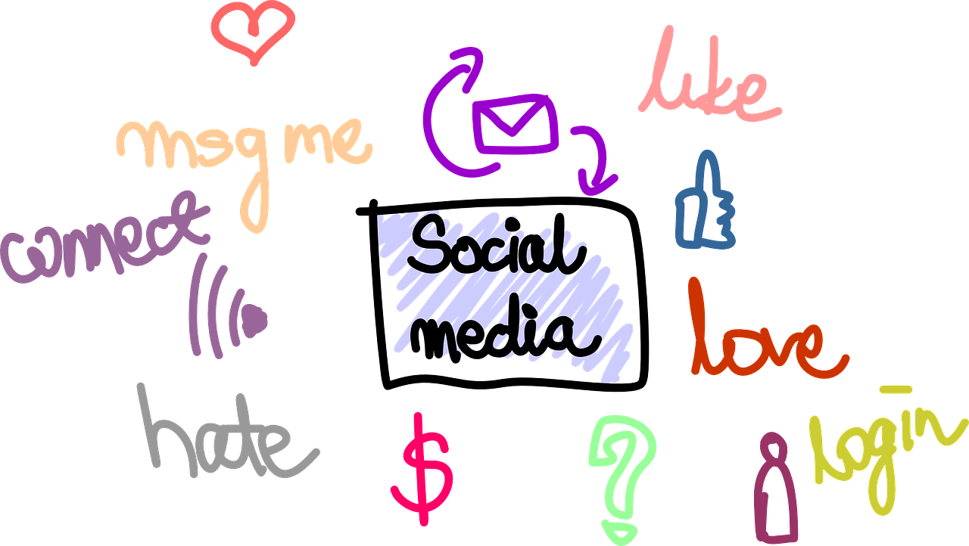
Supporting your son or daughter
Take an interest.
Listen and don’t judge.
Engage with them.
Use technology with them.
Do not become a ‘sharent’ - lead by example.
Talk to other parents about any issues - join social media parents groups.
Open minded to technology.

Slide 18
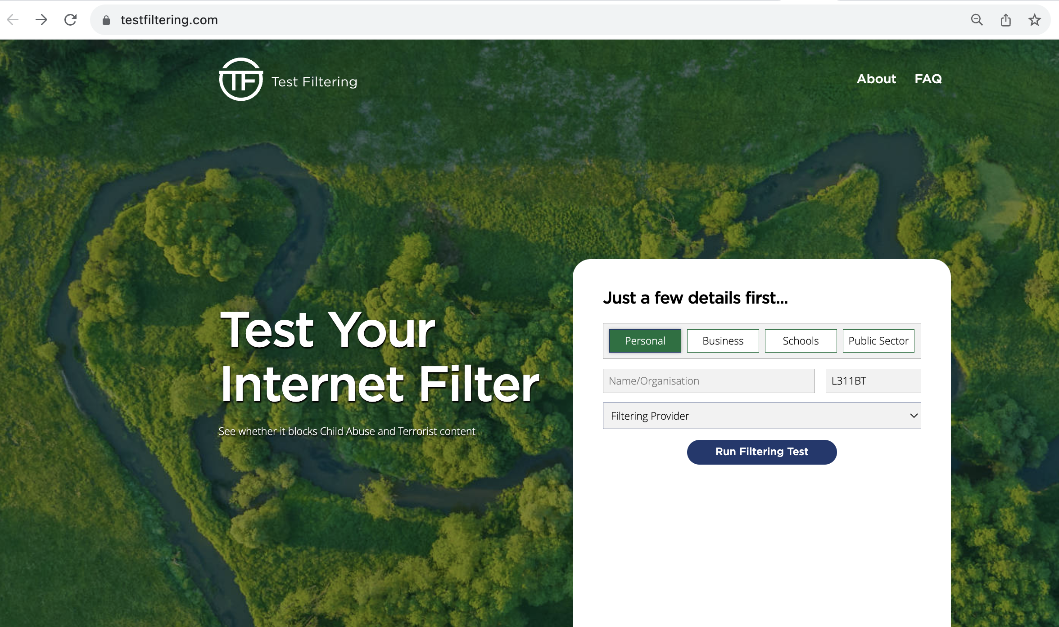
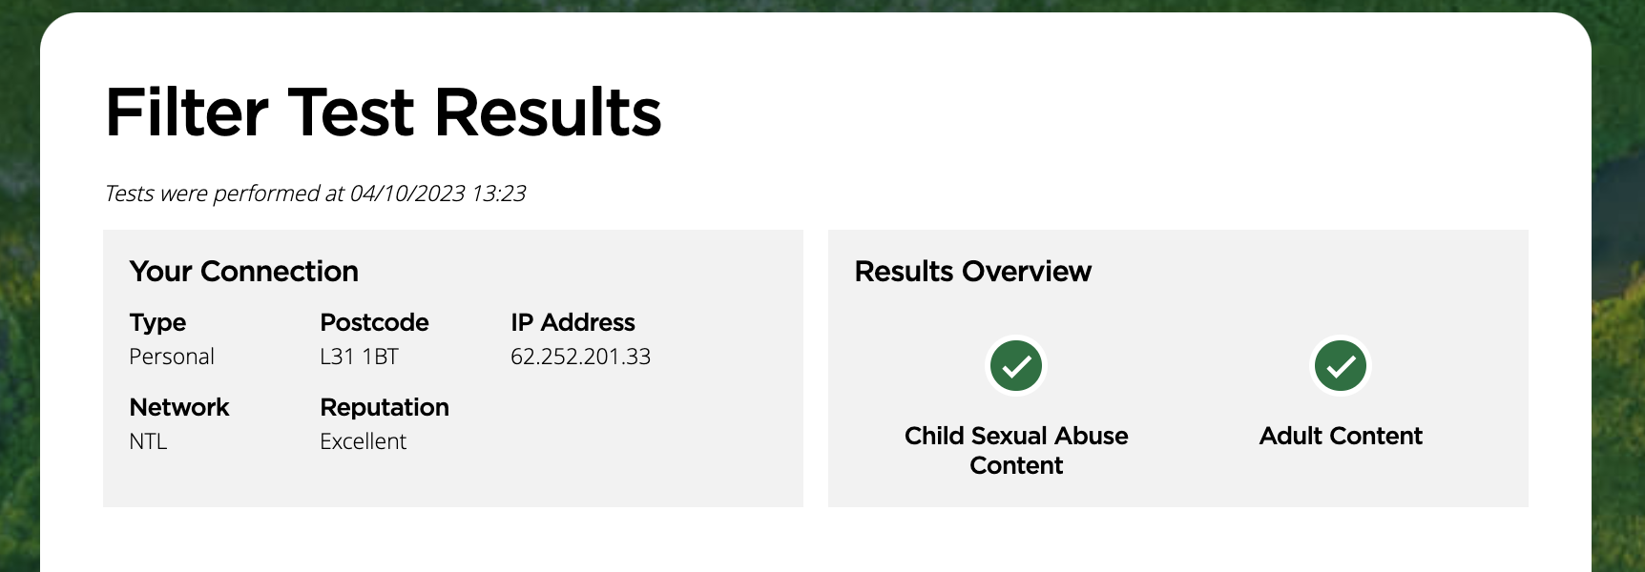
Test your Home Filtering
https://testfiltering.com/

Slide 19
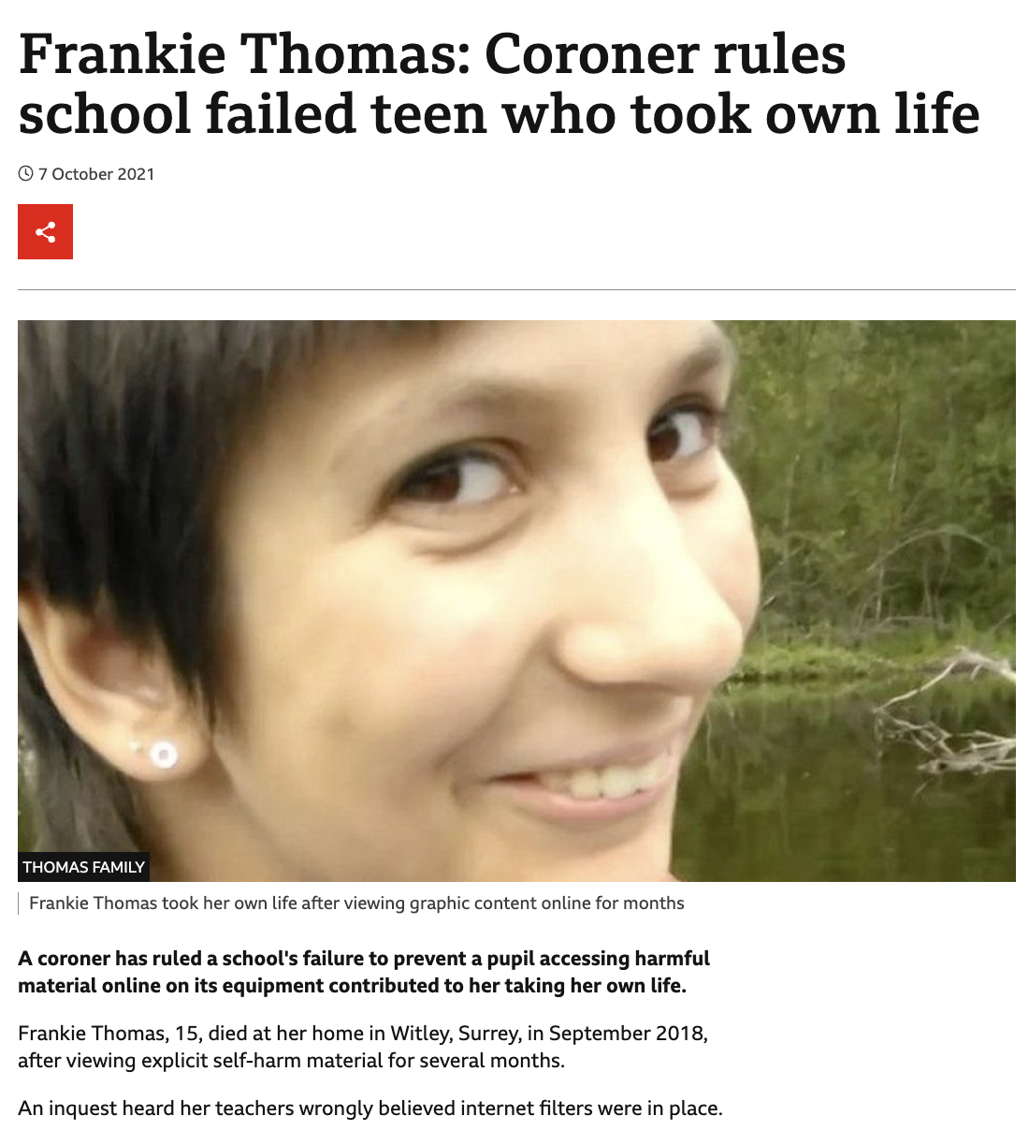
https://www.bbc.co.uk/news/uk-england-surrey-58817821
Notes:
In particular you should pay attention to the changes to the filtering and monitoring element of Keeping Children Safe, the case of Frankie Thomas last year should act as a reminder to us all that we should not just take the word of our technicians we should be testing filtering solutions ourselves or challenging our technical providers to evidence it is fit for purpose.

Slide 20
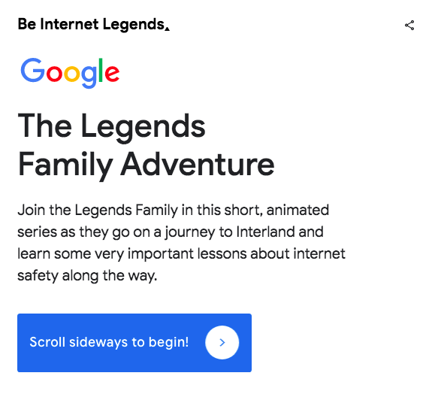
The Legends Family Adventure

Slide 21
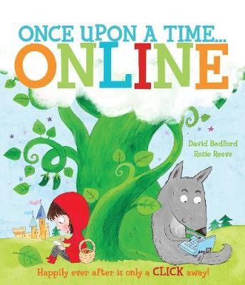
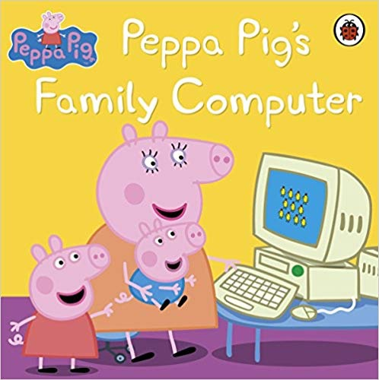
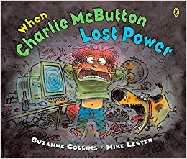
Online Safety Books

Slide 22
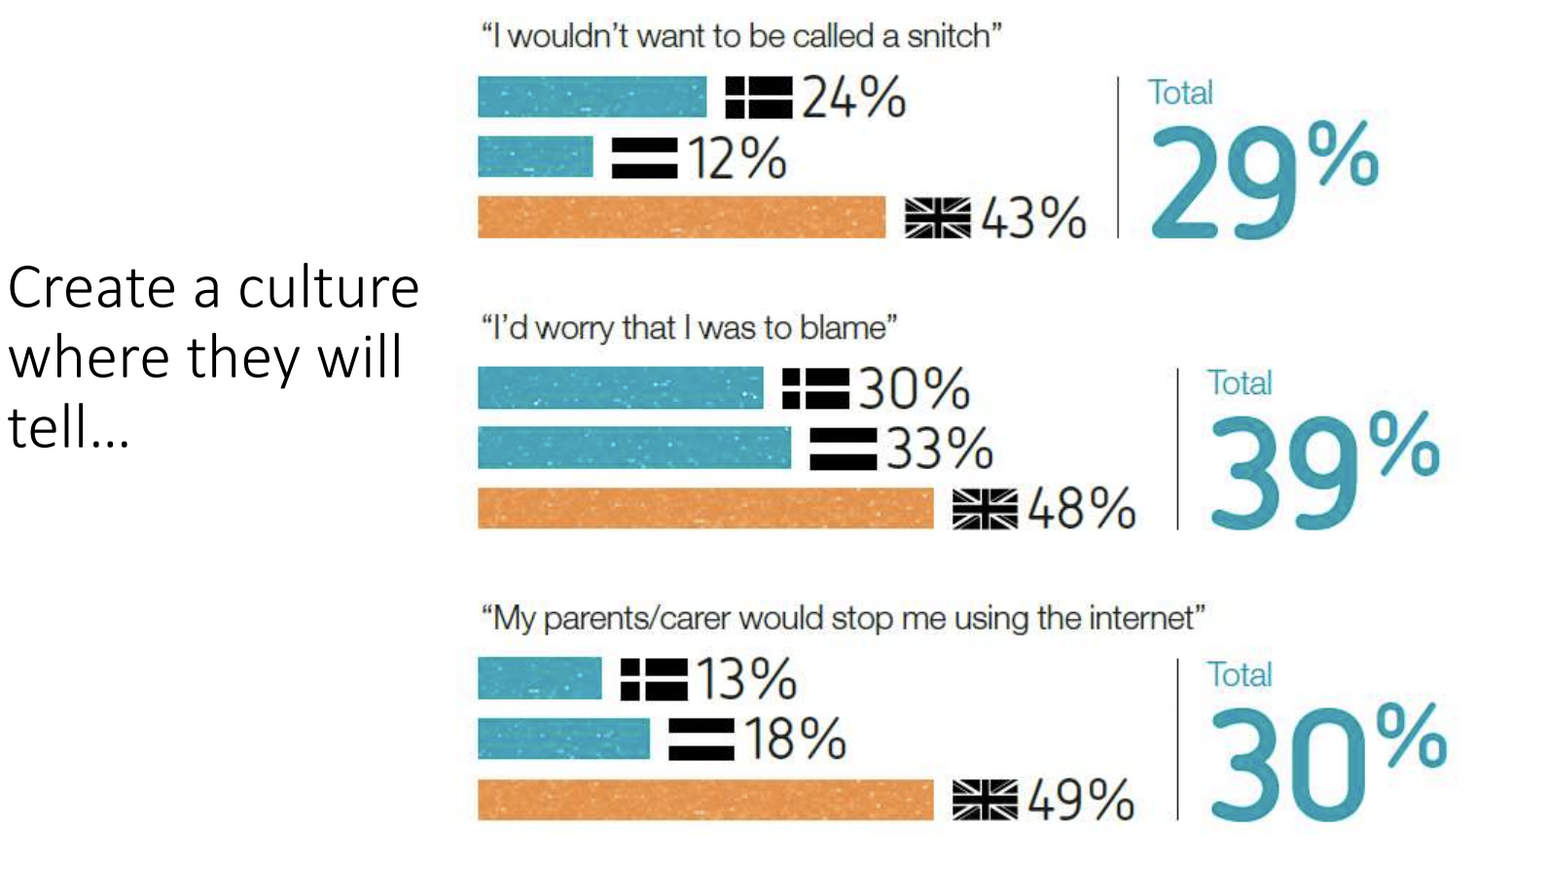
Children will make mistakes…

Slide 23
Parental Controls

Slide 24
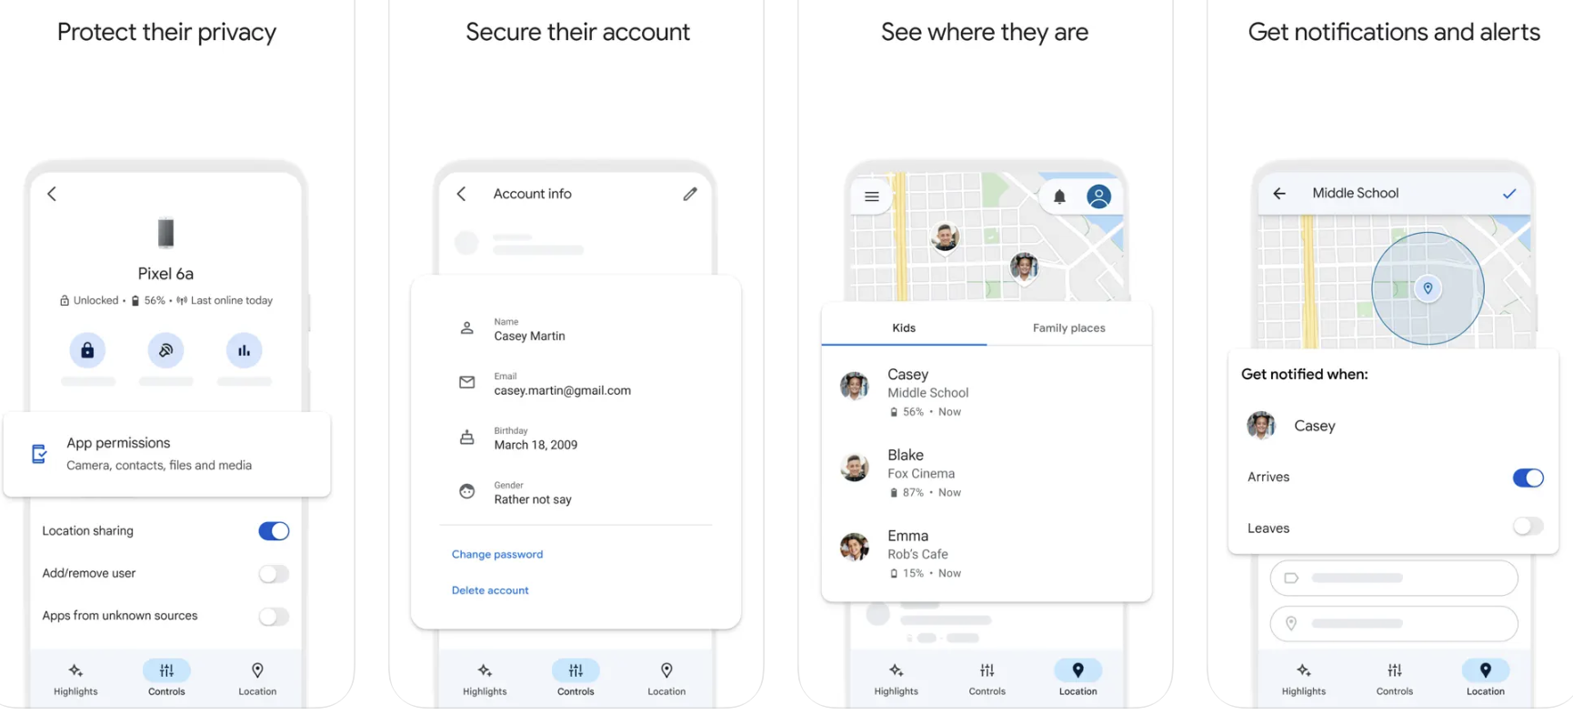
Google Family Link
Available on App and Android Stores.
Monitor Screen Time.
Manage Apps.
Set sleep time.
See where they are.

Slide 25
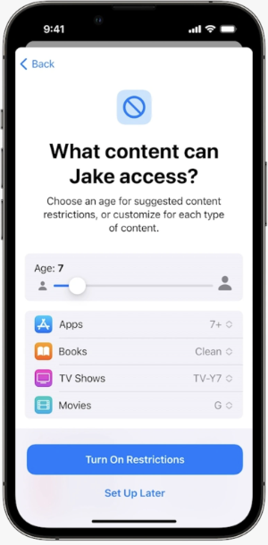
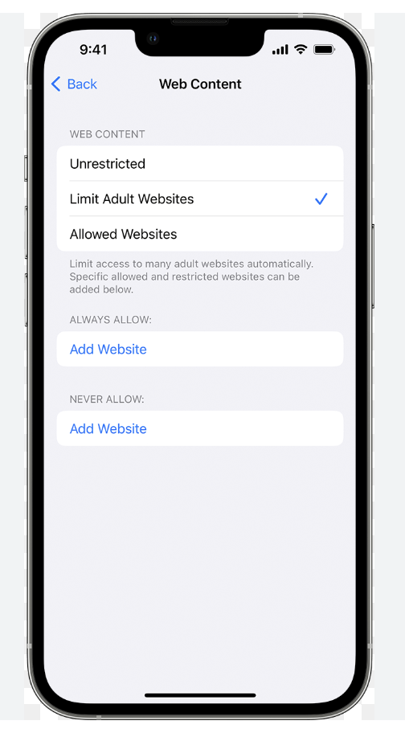
Apple Parental Control
Restrict Apps
Set time limits
Filter web content
Restrict the game centre.

Slide 26
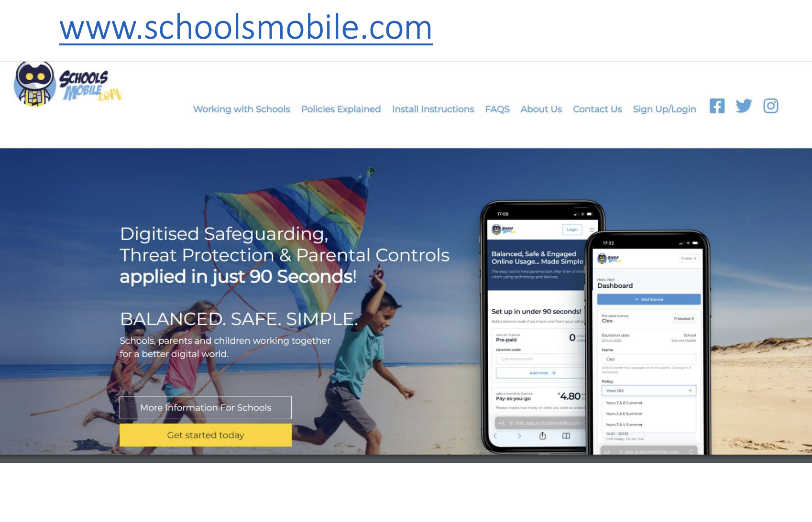

Slide 27
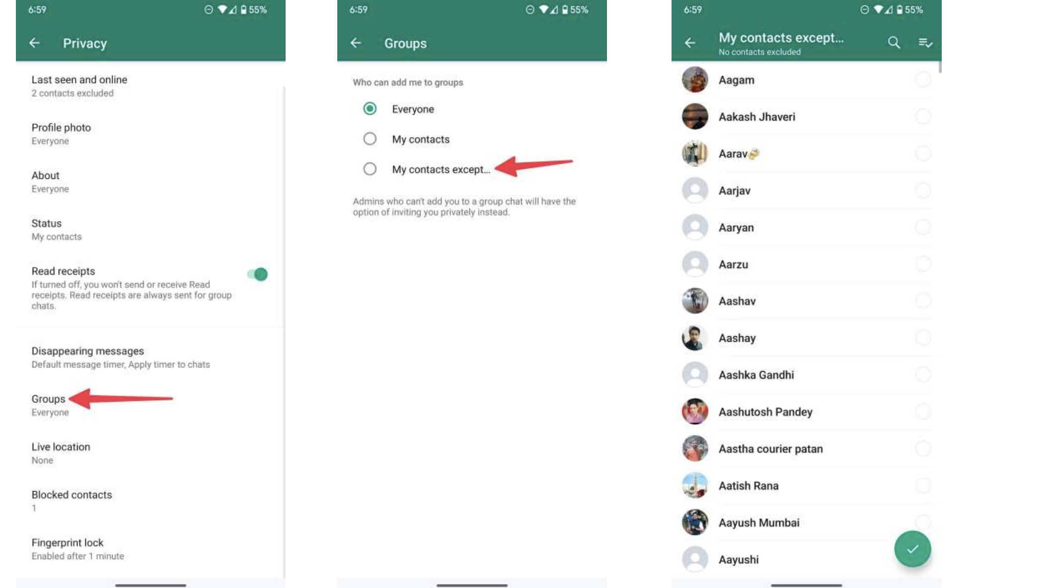
WhatsApp

Slide 28
Support for you
You can alway speak to:
CEOP
NSPCC
School
Or for more general information you can visit these sites:
UK Safer Internet Centre (https://www.saferinternet.org.uk/)
Internet Matters (https://www.internetmatters.org/)
The Parent Zone (https://parentzone.org.uk/home)

Slide 29
Live Streaming
This part of the presentation is only suitable for over 18s and may upset some parents.

Slide 31
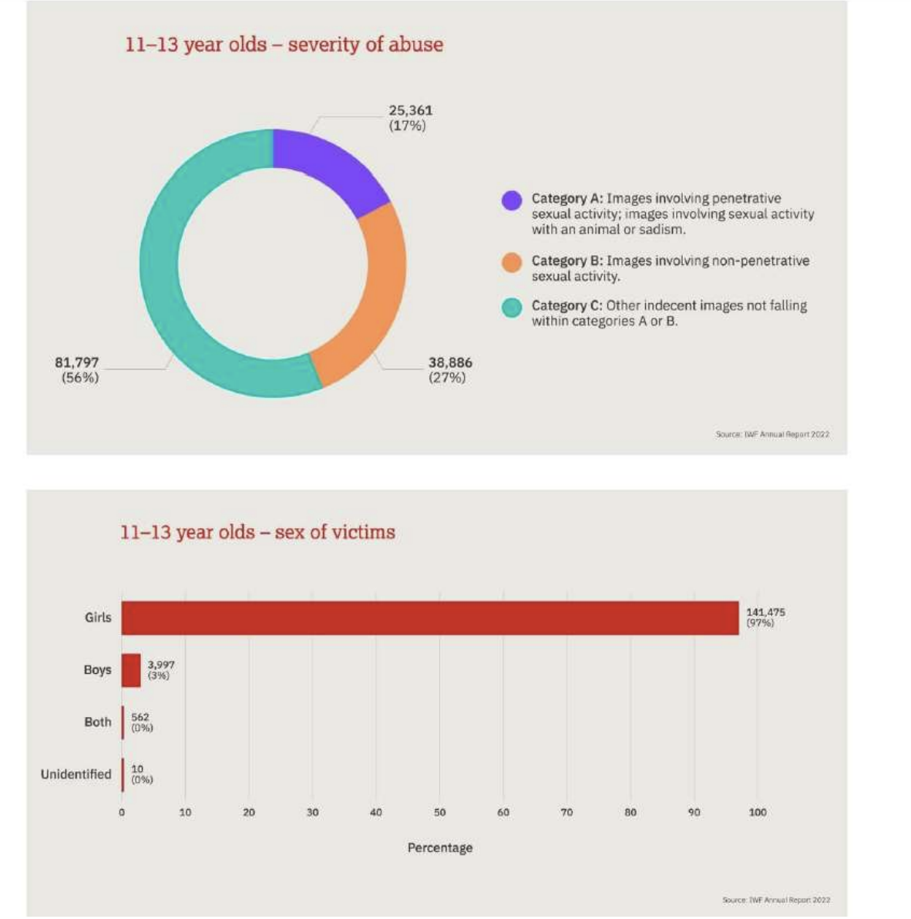

Slide 32
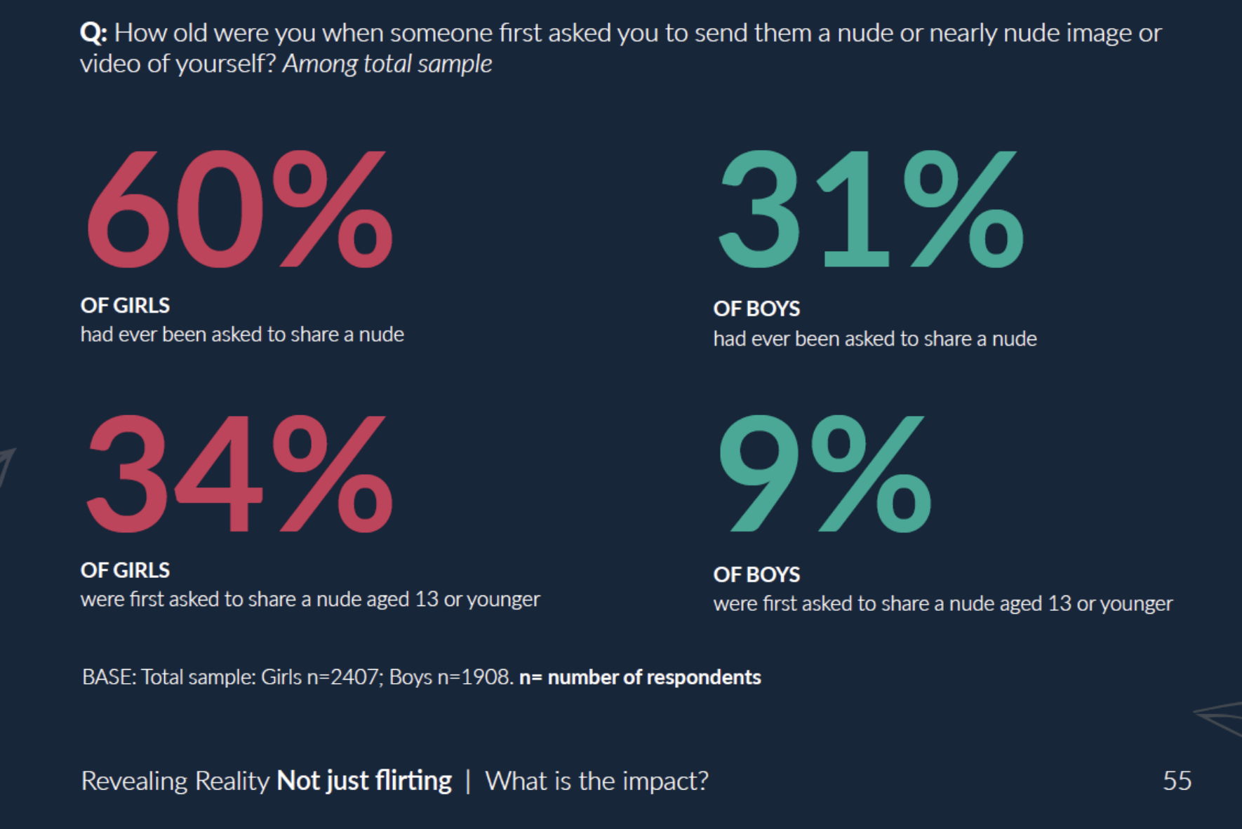

Slide 33
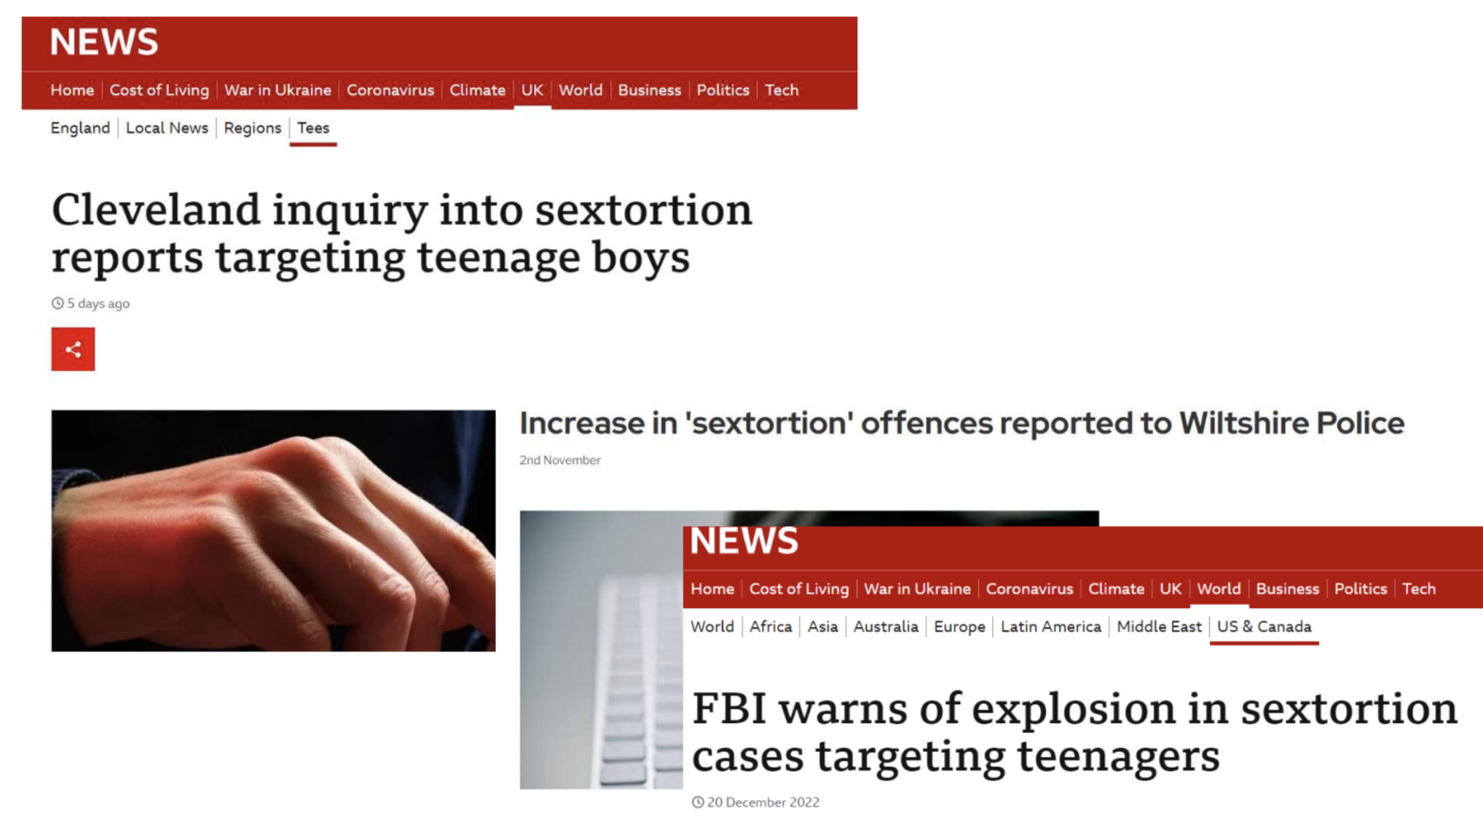
Contact

Slide 34
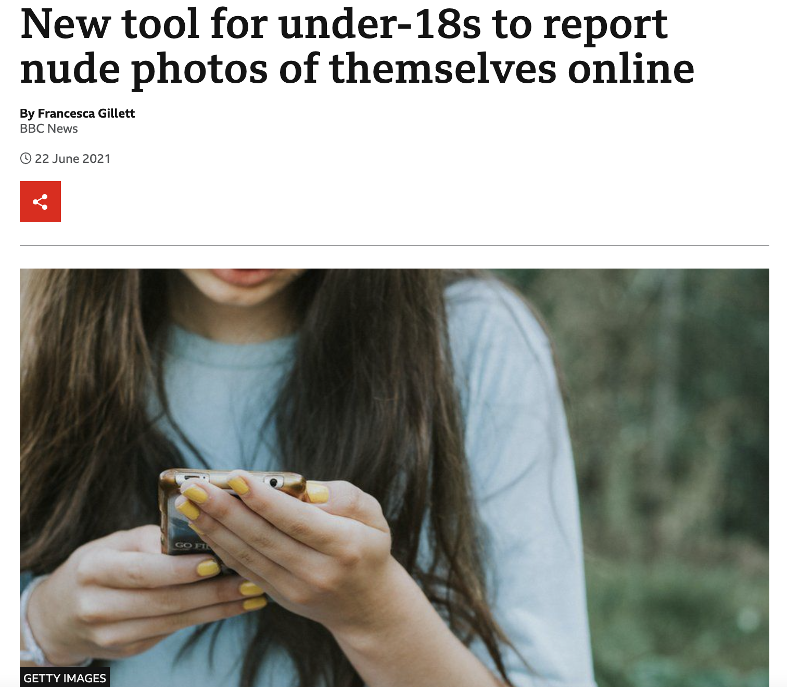
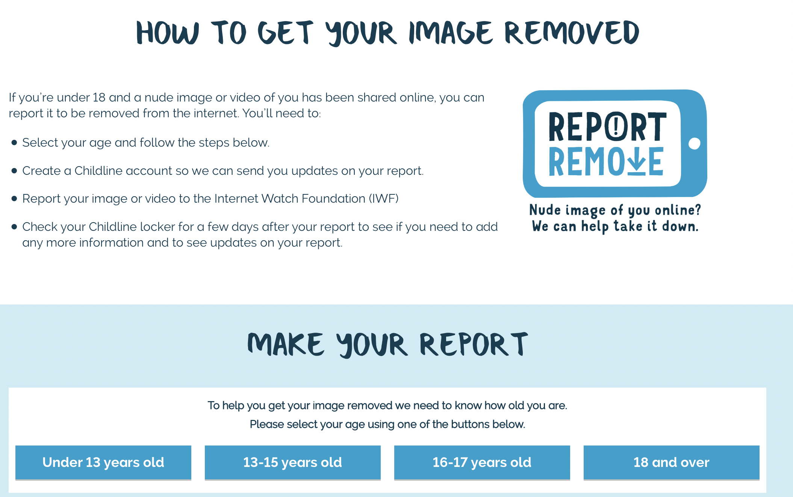
Report Remove

